Slide 1
Accelerating Information Theoretic Approach of Community Detection using Distributed and Hybrid Memory Parallel Schemes
6th November, 2020
Md A M Faysal and Shaikh M Arifuzzaman

Slide 2
Community Detection
There is no bold definition of the term community in the context of network analysis
Some networks (graph) divide naturally into groups of vertices with dense connections internally and sparse connections among the groups
The task of finding that group structure is generally known as community detection

Slide 3
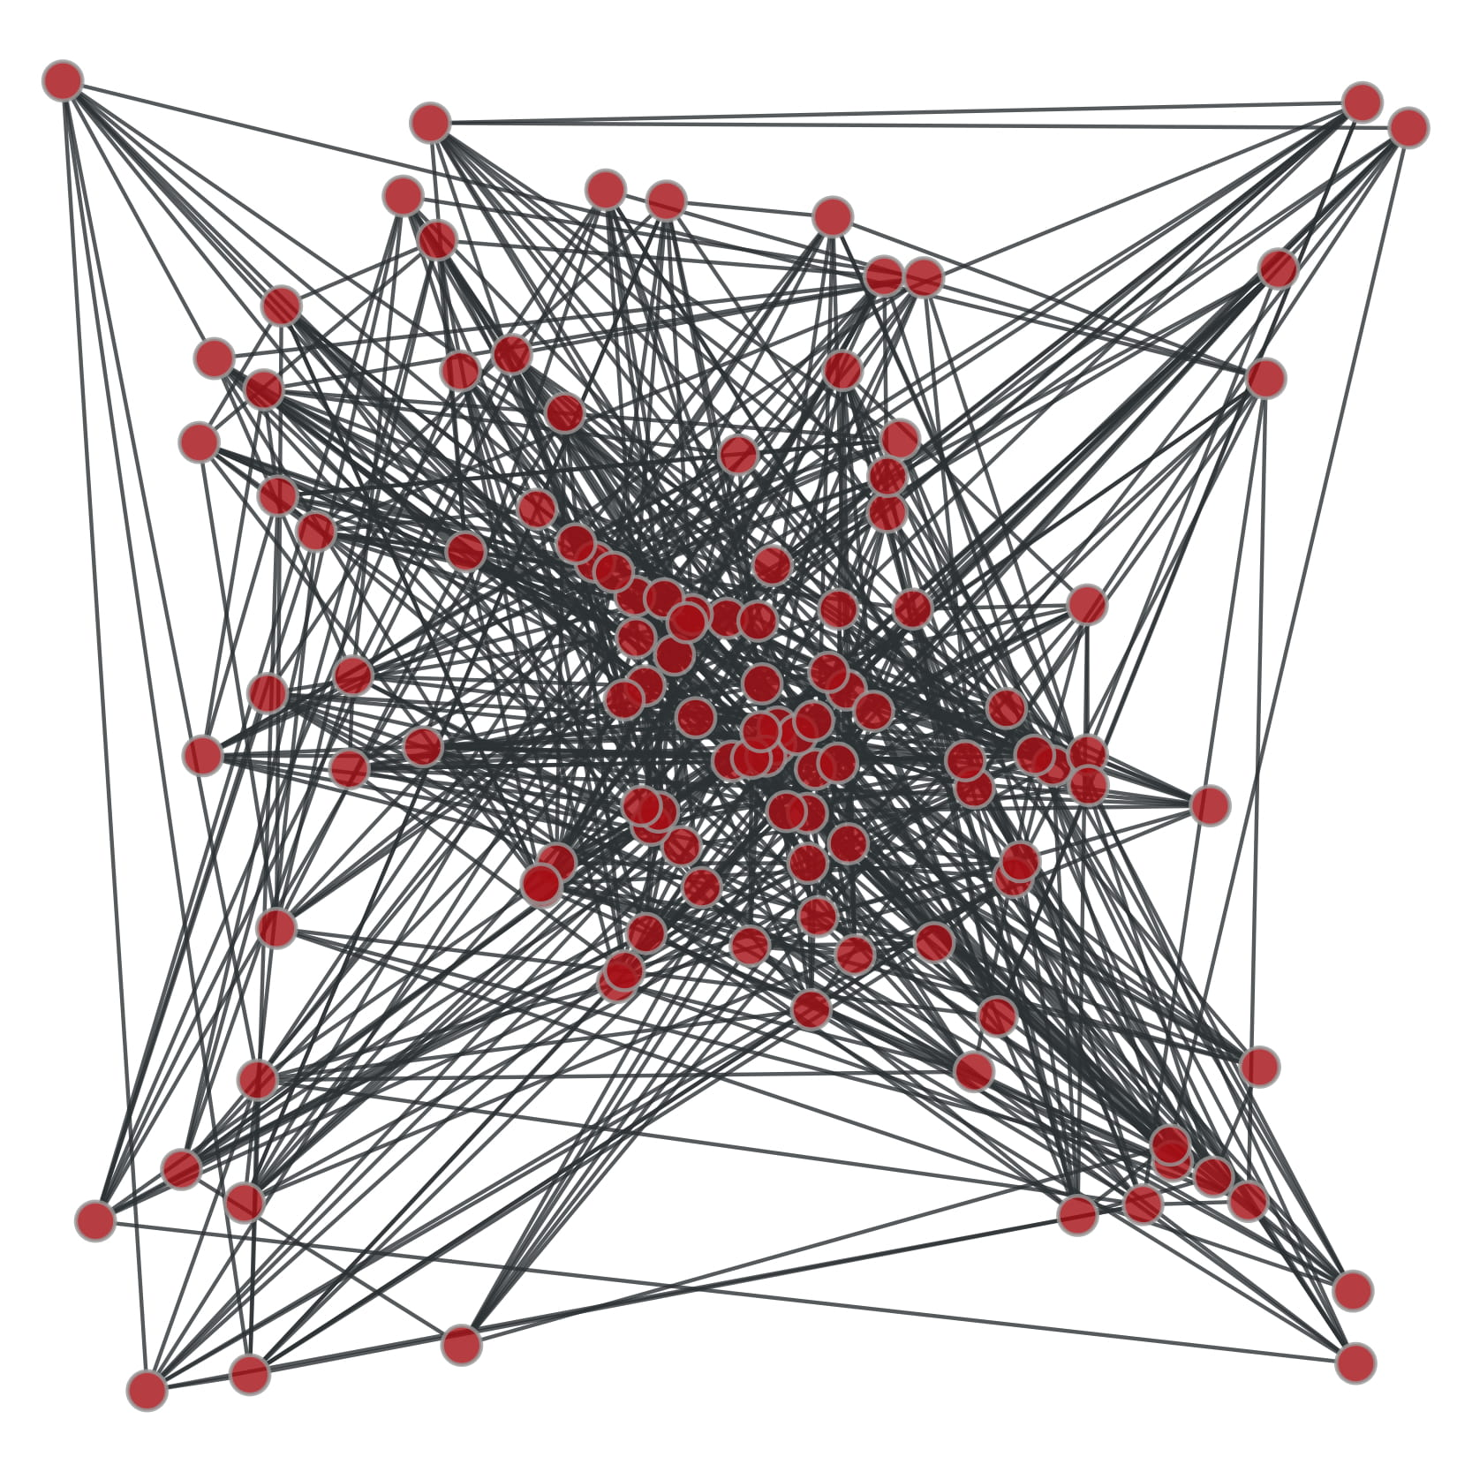
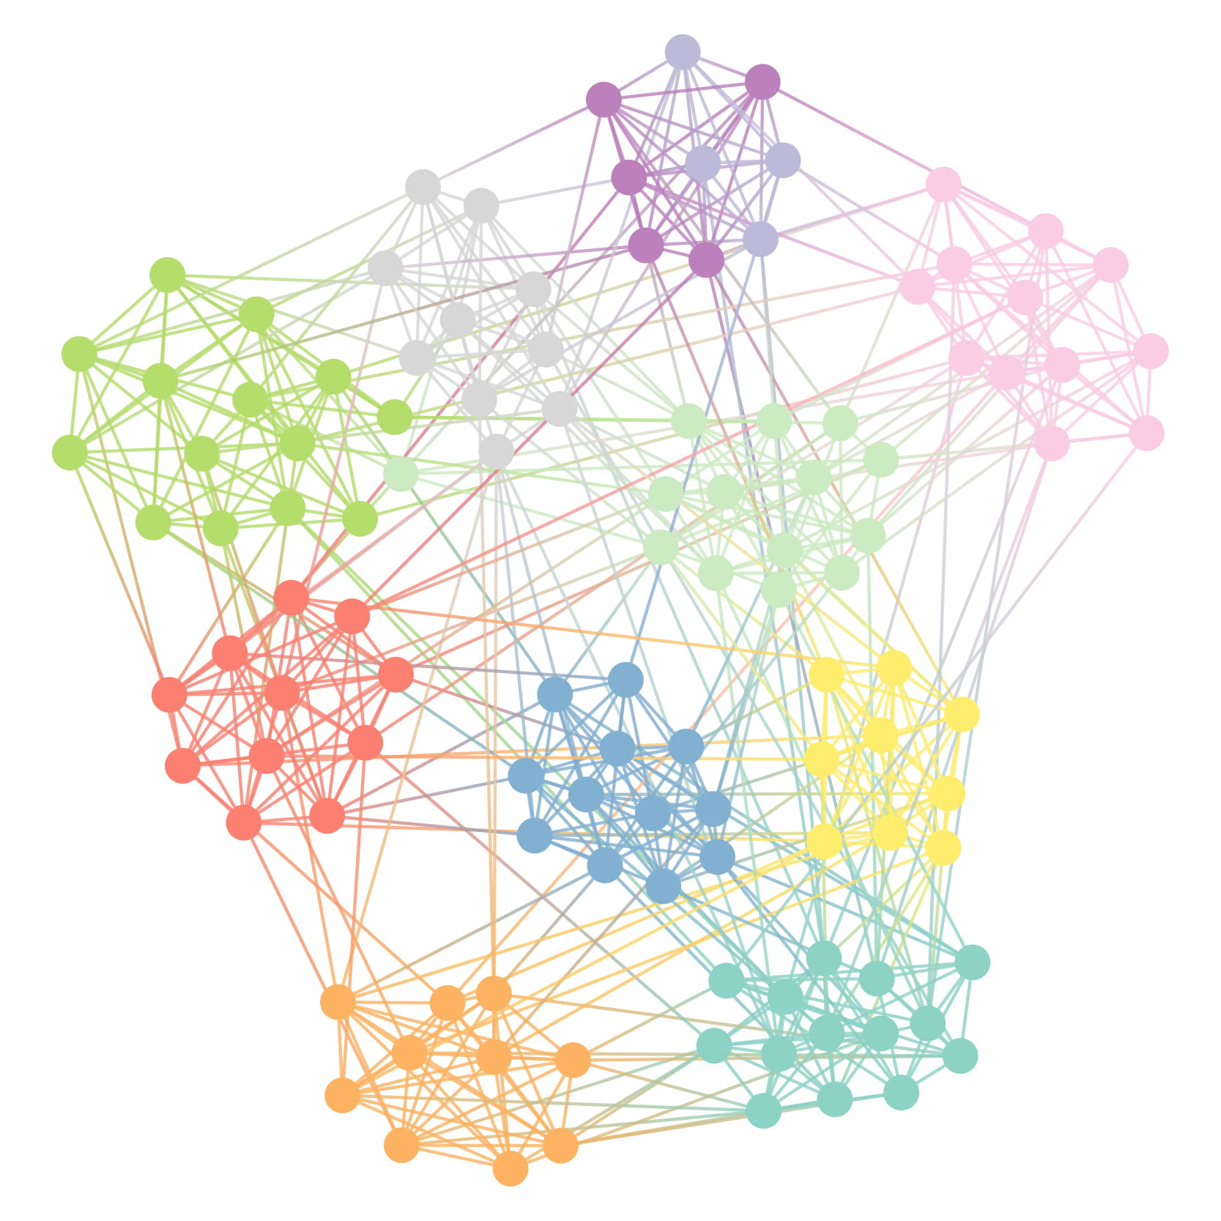
Community Detection
American College football: network of American football games between Division IA colleges during regular season Fall 2000, M. Girvan and M. E. J. Newman, Proc. Natl. Acad. Sci. USA 99, 7821-7826 (2002)

Slide 4
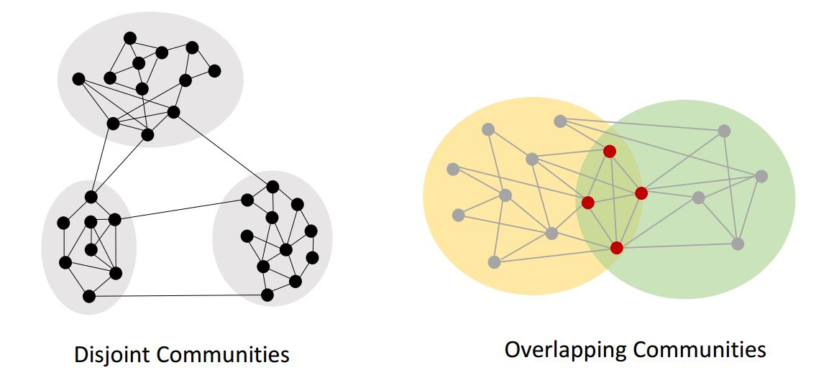
Types of Community Structures
Disjoint Community
Overlapping membership
Other types include hierarchical and local communities

Slide 5
Problem of Focus
Finding disjoint community structure
A few approaches
Community Detection Methods | Network Type | Drawbacks
Spectral methods | Static | - Not computationally efficient - Not reliable for sparse networks
Information-Theoretic Approach | Static | - High time complexity
Modularity Optimization Approach | Static | - Resolution limit problem
Stochastic Block Modeling Approach | Static / Dynamic | - High time complexity
Notes:
Spectral methods based on spectral properties of the network. The idea is, if communities are well-identified, the eigenvector components corresponding to vertices in the same community should have similar values. The eigenvalue spectrum of the Laplacian matrix, the adjacency matrix is used to detect communities. A projection of vertices into a metric space by using eigenvectors as coordinates is generated. A limited number of eigenvectors, say $n$ is considered. Each vertex in the network is considered as a geometric point in a Euclidean n-dimensional space where coordinates are the eigenvector components corresponding to that vertex. The points are then grouped using traditional clustering techniques such as K-means clustering.

Slide 6
Information Theoretic Approach
Greater accuracy
Topped in LFR benchmark by Lancichinetti et al. [1]
Limitation
Approximation based strategy
Sequential algorithm
Notes:
1. A. Lancichinetti and S. Fortunato, “Community detection algorithms: A comparative analysis,” Phys. Rev. E, vol. 80, p. 056117, Nov 2009. [Online]. Available: https://link.aps.org/doi/10.1103/PhysRevE.80.056117
LFR - Lancichinetti–Fortunato–Radicchi

Slide 7
The Infomap
Infomap uses a standard data compression technique on a dynamic process (random walk).
It exploits the duality between compressing a data set and extracting significant patterns or structures in that data set
A branch of statistics named Minimum Description Length (MDL)[2] discusses the duality
Notes:
2. https://direct.mit.edu/books/book/3813/The-Minimum-Description-Length-Principle

Slide 8
The Infomap
The target is to find an optimal compression code.
Optimizing the code means detection of regularities or patterns corresponding to the structural features of that network.
Theoretical limit of optimal compression based on the regularity of the structure is discussed in Shanon’s Minimum Entropy [3] theorem.
The optimization function is called the mapequation.
Notes:
3. http://people.math.harvard.edu/~ctm/home/text/others/shannon/entropy/entropy.pdf
Shannon’s source coding theorem implies that when you use n codewords to describe the n states of a random variable X that occur with frequencies pi, the average length of a codeword can be no less than the entropy of the random variable X itself: H(X) ! "#1 n pi log(pi).

Slide 9
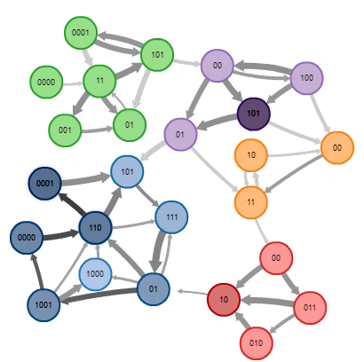
Dynamic Process Reveals Community Structures
Java applet ref: https://www.mapequation.org/apps/MapDemo.html#applet

Slide 10
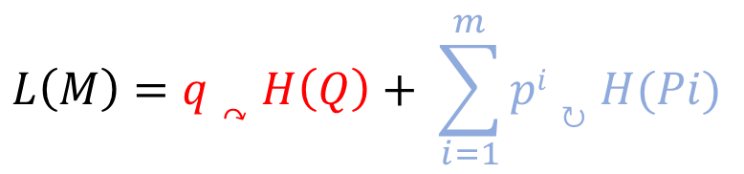
The MapEquation
$$L\left(M\right)=q↷H\left(Q\right)+ \sum_{i=1}^{m}{pi↻H(Pi)}$$
q↷
--- Sum of exit probability of the random walk for each module
H(Q) --- Average code length for the movement between modules (inter-module entropy)
p^{i}↻
--- Stay probability of the random walk within a module i
H(P^{i})
--- Average code length of the random walk within the module (intra-module entropy)
Red term describes inter-modular movements
Blue term describes movement within modules

Slide 11
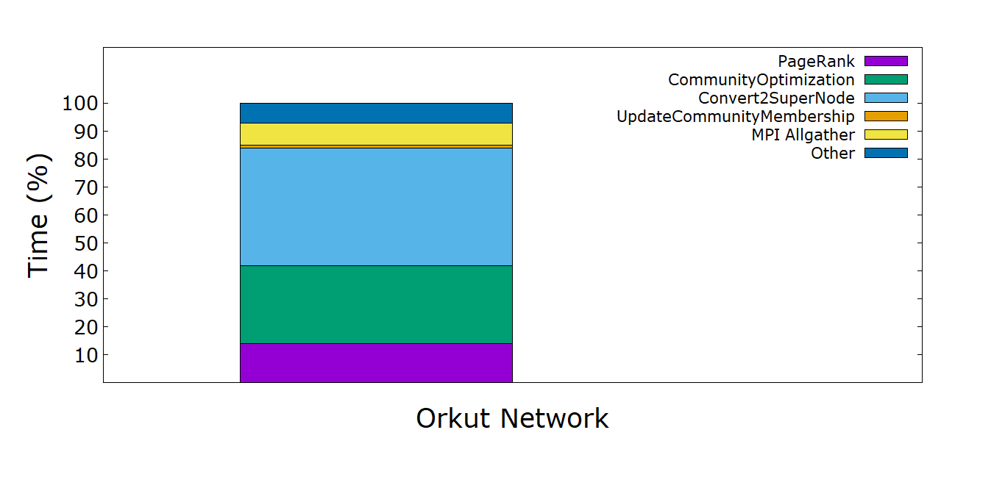
Computation Kernels in Infomap
PageRank by Power Iteration
CommunityOptimization
UpdateCommunityMembership
Convert2SuperNode

Slide 12
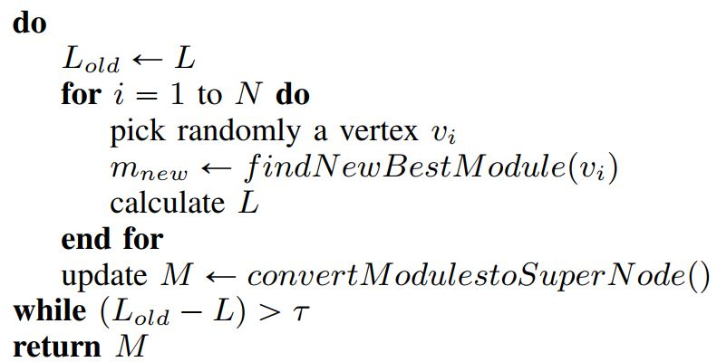
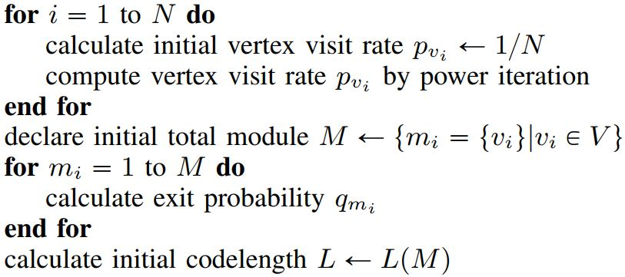
Sequential Infomap Algorithm
Initialization Phase
Optimization Phase

Slide 13
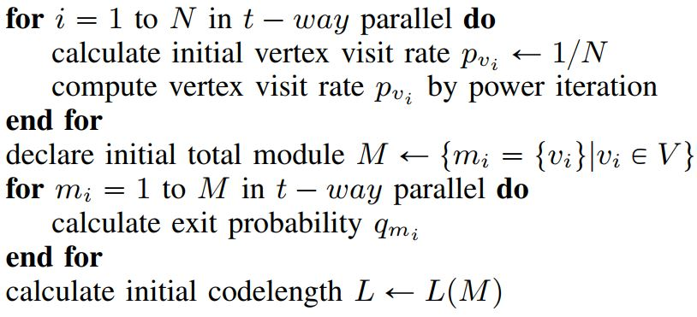
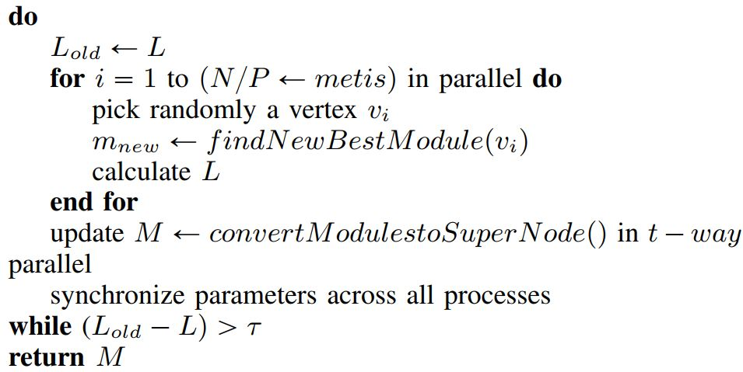
Hybrid Infomap Algorithm
Initialization Phase
Optimization Phase

Slide 14
Challenges
Maintaining the accuracy in a distributed environment with minimal information passing
Maintaining uniformity of community assignment
Preventing vertex-bouncing problem
Avoid processing non-active vertices for community assignment

Slide 15
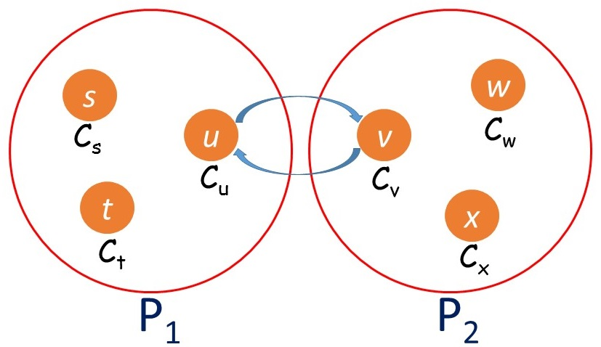
Vertex Bouncing Problem
Vertices with close affinity cause multiple redundant moves
Solution: If C_{u}< C_{v} permit the move, otherwise do not permit

Slide 16
Active Vertices Heuristic
In the initial few iterations, most of the vertices change their communities
Very few vertices change communities in later iterations
Can save computation time if inactive vertices are not recomputed
Solution: Maintain a list of active vertices
Active vertices and their immediate neighbours only be considered for subsequent iteration

Slide 17
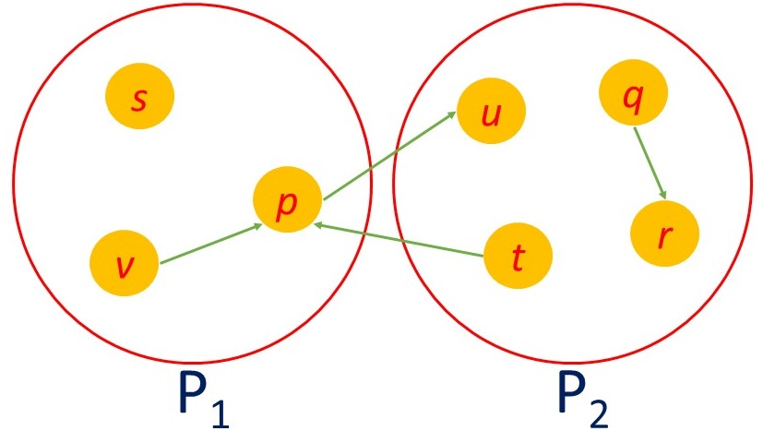
Community Assignment Ordering In Sequential Approach
p → u, C_{p} ← C_{u}
t → p, C_{t} ← C_{p}(=C_{u})
v → p, C_{v} ← C_{p} (=C_{u})
q → r, C_{q} ← C_{r}
Sequential Ordering

Slide 18
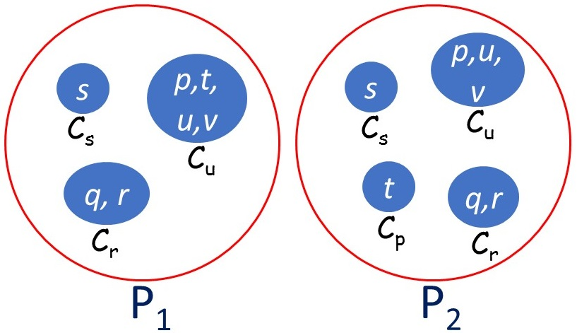
Incorrect Module Assignment in Distributed Processes
p → u, C_{p} ← C_{u}
v → p, C_{v} ← C_{p} (=C_{u})
P1
C_{p} ← C_{u}
C_{v} ← C_{p} (=C_{u})
C_{t} ← C_{p}(=C_{u})
C_{q} ← C_{r}
After sync in P1
t → p, C_{t} ← C_{p}
q → r, C_{q} ← C_{r}
P2
C_{t} ← C_{p}
C_{q} ← C_{r}
C_{p} ← C_{u}
C_{v} ← C_{p} (=C_{u})
After sync in P2

Slide 19
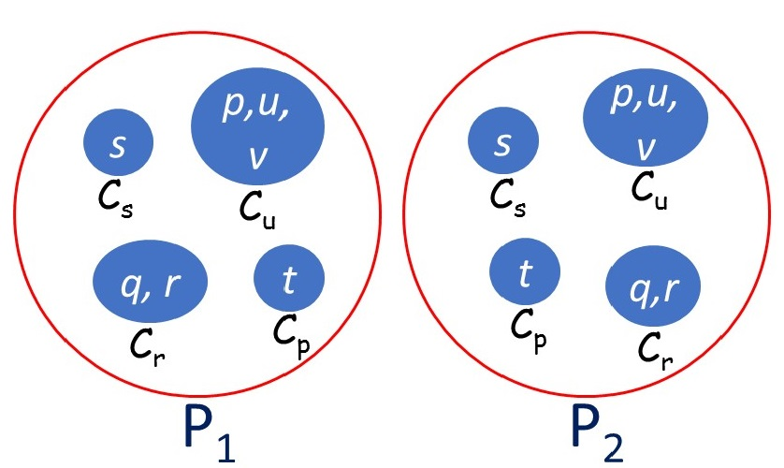
Uniformity by Priority Ordering
p → u, C_{p} ← C_{u}
v → p, C_{v} ← C_{p} (=C_{u})
P1
C_{p} ← C_{u}
C_{v} ← C_{p} (=C_{u})
C_{t} ← C_{p}
C_{q} ← C_{r}
After sync in P1
t → p, C_{t} ← C_{p}
q → r, C_{q} ← C_{r}
P2
C_{t} ← C_{p}
C_{q} ← C_{r}
C_{p} ← C_{u}
C_{v} ← C_{p} (=C_{u})
The decision for each move in each process is final
Do not update community membership based on local information during synchronization phase
After sync in P2

Slide 20
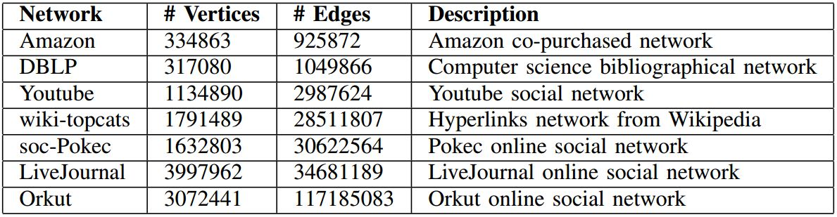
Network Dataset

Slide 21
Experiment Specifications
Implementation platform: Linux
Language: C++
Frameworks: Metis , MPI, OpenMP

Slide 22
LONI Compute Node Specification
Intel Xeon E5-2680v2 processor with 2.8 GHz
Sockets 2, 10 cores per socket
1 thread per core
32 KB L1 cache (latency ~10 cycles)
256 KB L2 cache (latency ~22 cycles)
25 MB L3 cache (latency ~40 cycles)
64 GB memory
Latency ~200 cycles
56 Gb/sec Infiniband

Slide 23
Performance Analysis
Quantitative Analysis Metrics
→Execution Time Reduction
→Speedup
→Load Balancing
Quality Analysis Metrics
→Modularity
→Conductance
→Convergence MDL

Slide 24
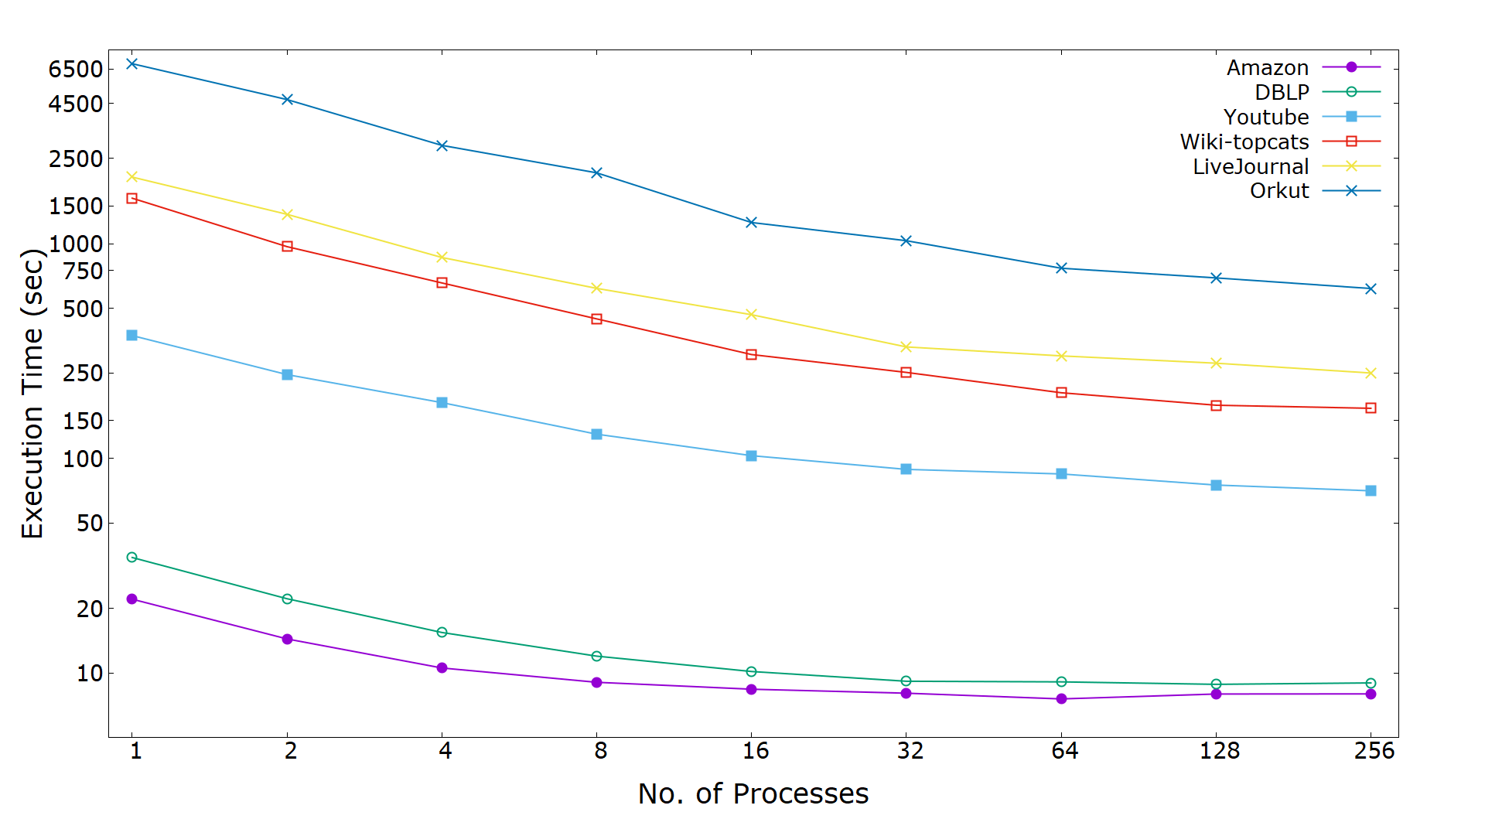
Reduction of Execution Time
Orkut network single core processing time 6888 seconds, processing time reduced to 617 seconds for 256 processes
LiveJournal network single core processing time 2041 seconds reduces to 249 seconds for 256 processes

Slide 25
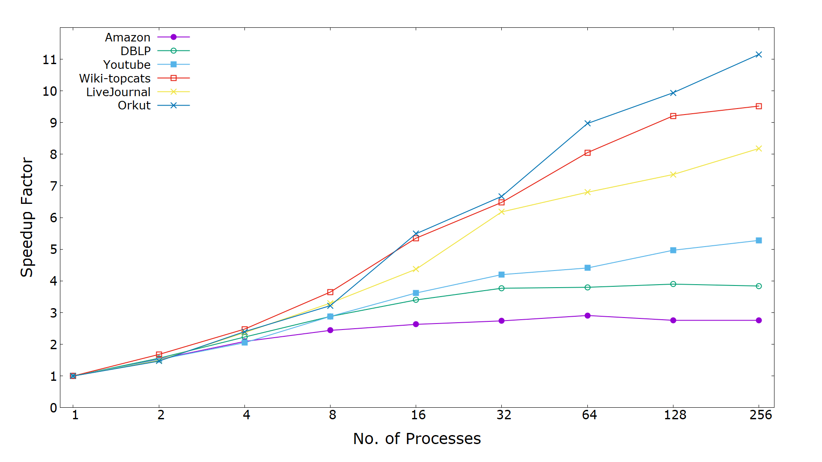
Parallel Speedup
Speedup gain of 9.5, 8, 11.2 times achieved for Wiki-topcats, LiveJournal and Orkut networks respectively

Slide 26
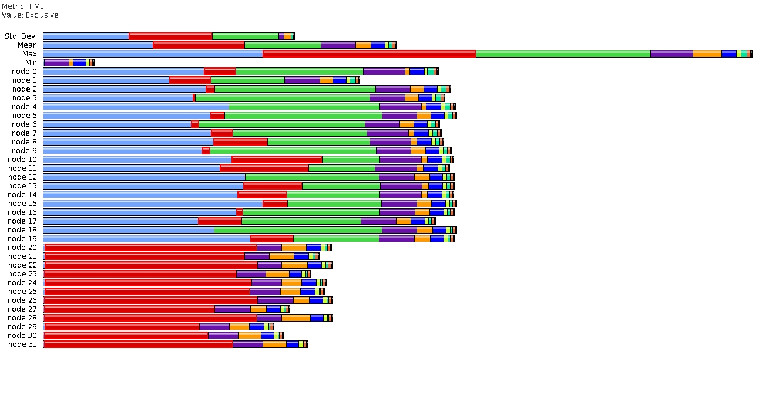
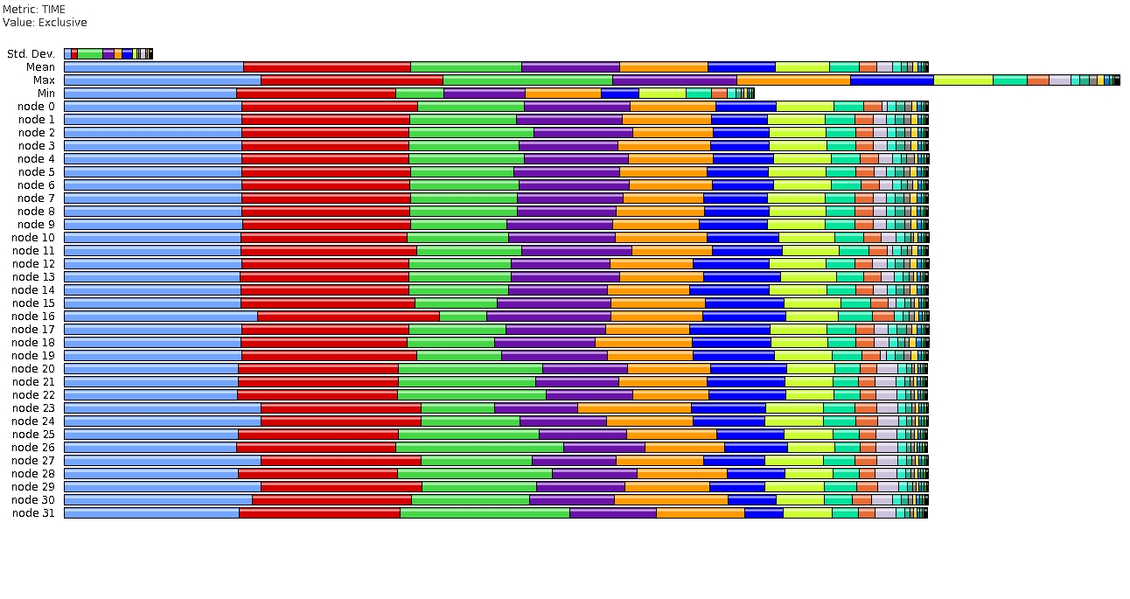
Load Balancing
Without Metis Partitioner
With Metis Partitioner

Slide 27
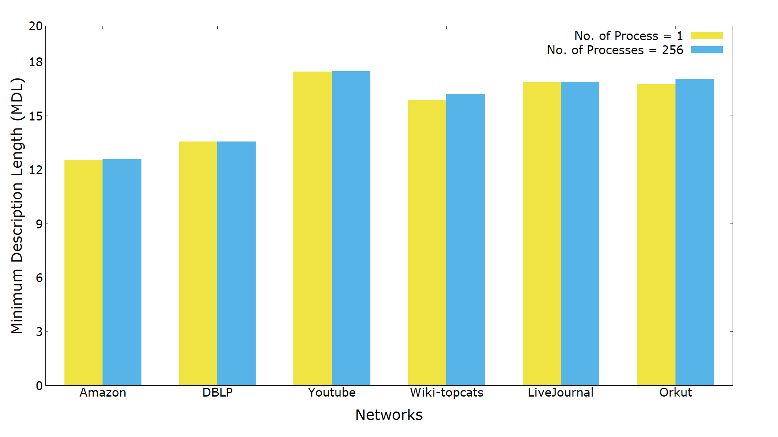
Convergence MDL
Convergence MDLs for LiveJournal network 16.87 and 16.89 for 1 process and 256 processes respectively
For Wiki-topcats, convergence MDL 15.89 and 16.23 for 1 process and 256 processes respectively with 2% deviation

Slide 28
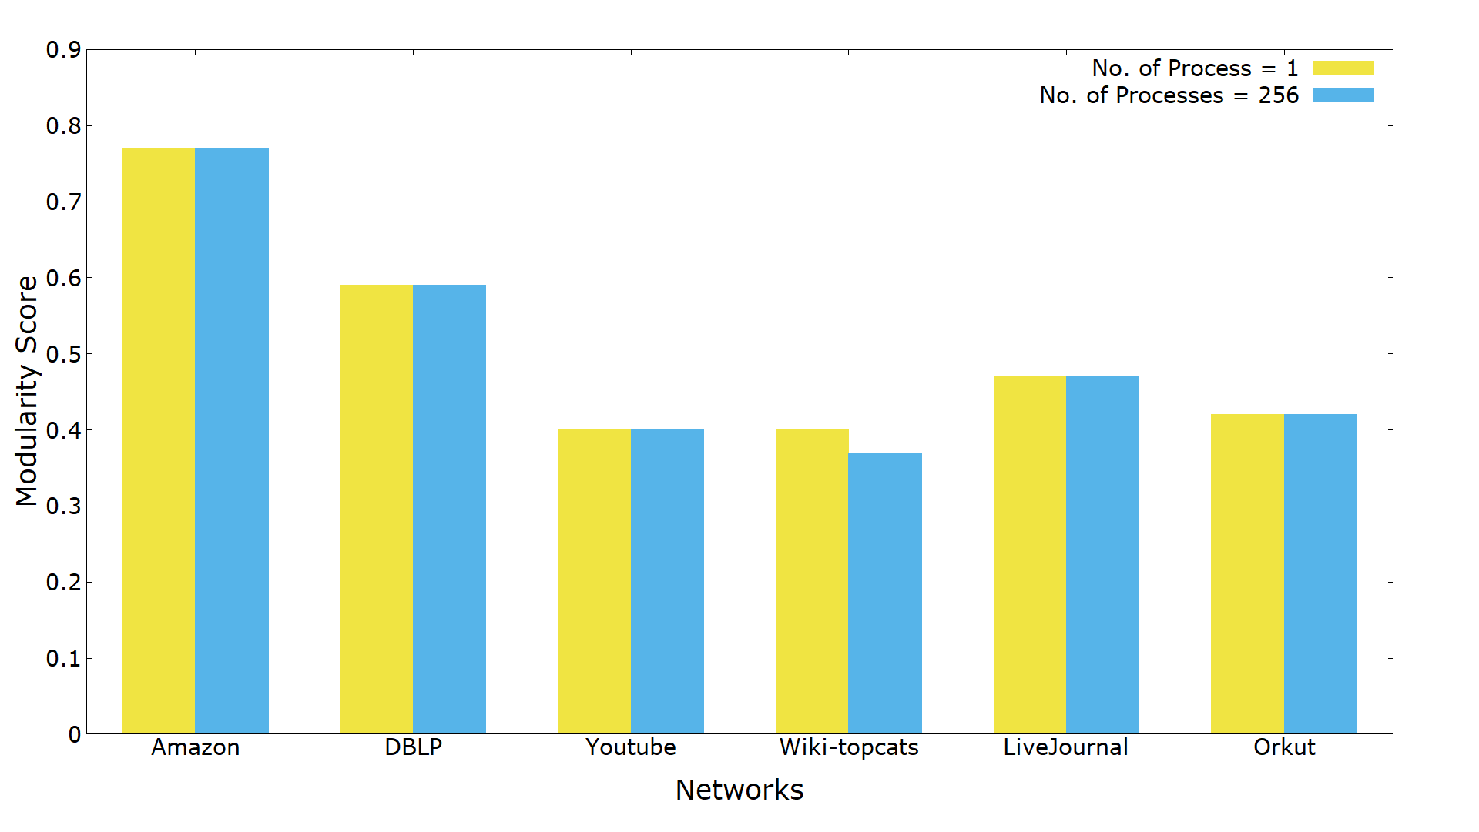
Comparison of Modularity
Modularity score 0.42 for Orkut network for both of 1 process and 256 processes executions

Slide 29
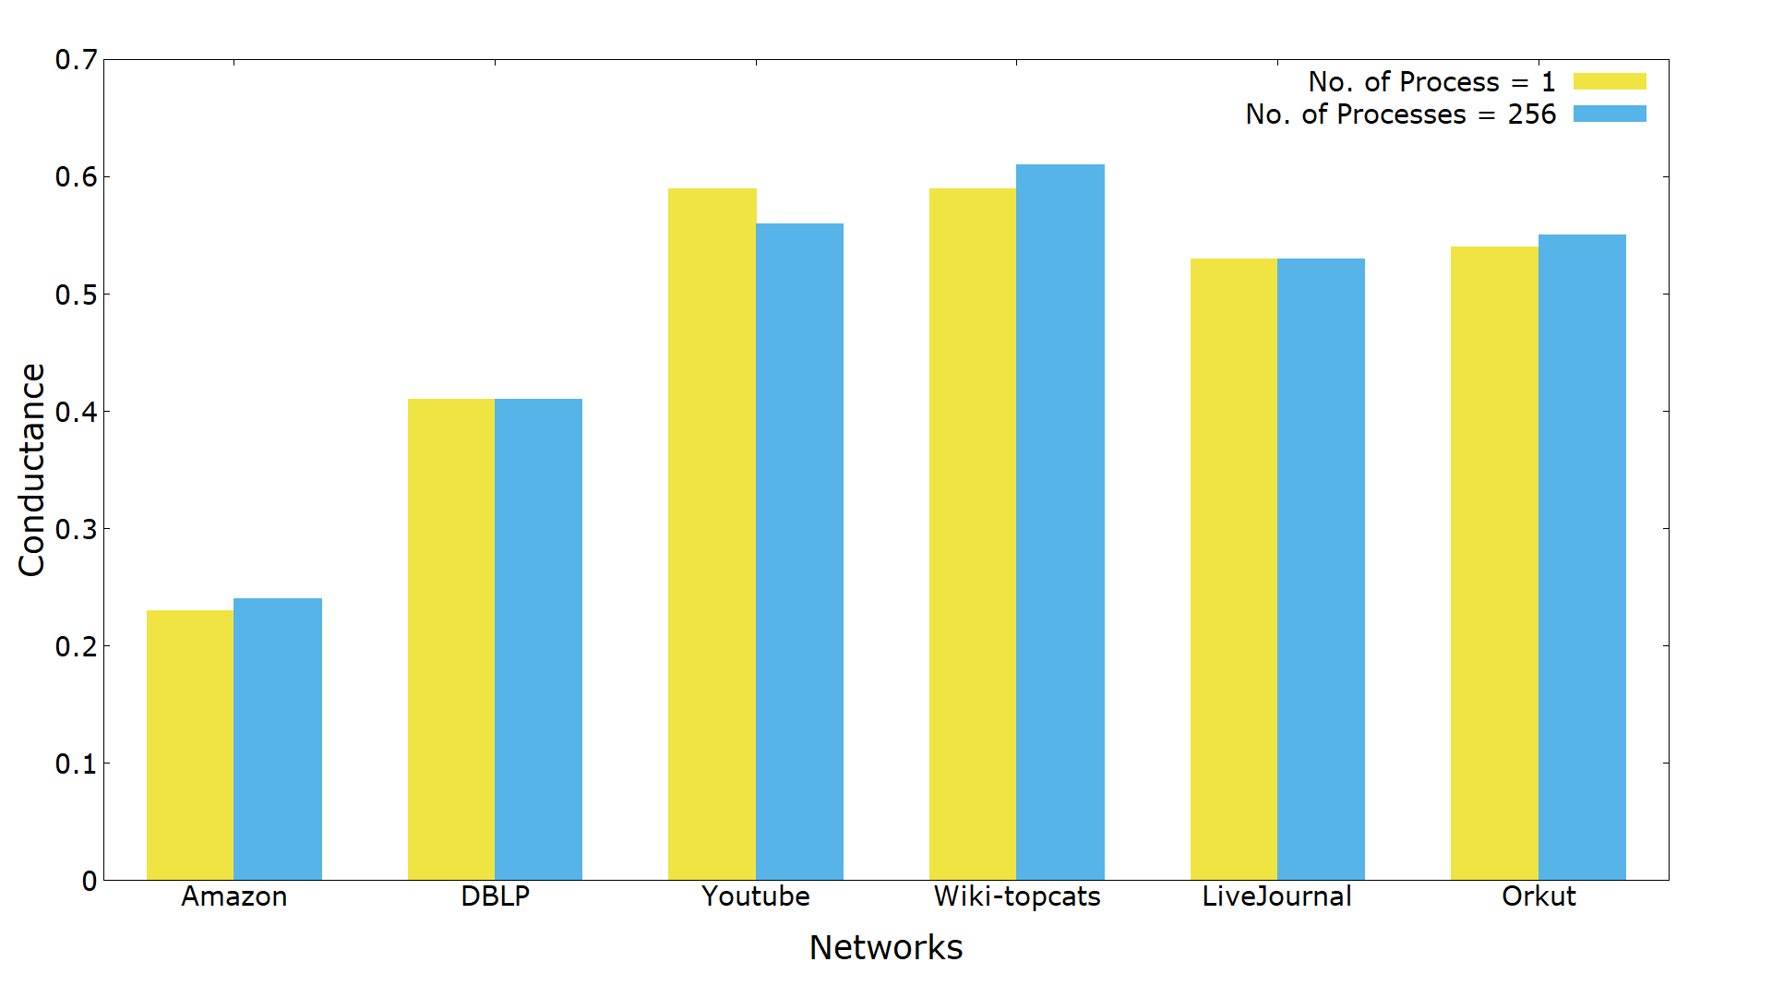
Comparison of Conductance
Conductance scores for Orkut network 0.54 and 0.55 for 1 process and 256 processes respectively
Low value of conductance means greater quality of the detected communities

Slide 30
Execution On LONI and Cori (knl, haswell)
4 MPI processes, 10 threads for each process, youtube social network dataset with 1.1 million vertices and 3 million edges
Kernel | LONI (sec) | Cori (haswell) (sec) | Cori (knl) (sec)
PageRank | 4.6 | 6.9 | 34.14
CommunityOptimization | 123.74 | 209.81 | 1049.57
Convert2SuperNodes | 23.66 | 39.32 | 187.50
updateMembership | 8.22 | 12.29 | 54.04

Slide 31
Appendix
Derivation of the MapEquation
CSR network format
Shanon's Minimum Entropy Theorem
Modularity
Conductance

Slide 32
Comparison With Existing Works
Work Name | Type | Strength | Weakness
Infomap | Sequential | - Highly accurate | - High computation time
RelaxMap | Shared-memory based parallel | - As accurate as Infomap | - Parallelism and scalability limited by number of processing core in a single machine
GossipMap | Asynchronous-distributed memory parallelism | - Parallel accuracy close to Infomap | - Distributed parallelism up to 128 processes
Distributed Infomap | Synchronous distributed memory parallelism | Accurate as RelaxMap - Distributed Parallelism up to 512 processes | - Moderate Speedup gain
Hybrid Infomap | Synchronous distributed + shared memory parallelism | Accurate as Relaxmap High speedup gain

Slide 33
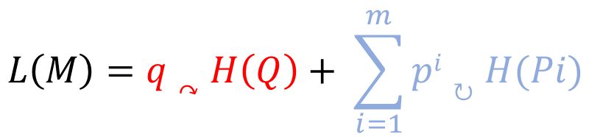
MapEquation
$$L\left(M\right)=q↷H\left(Q\right)+ \sum_{i=1}^{m}{pi↻H(Pi)}$$
The first term of the equation (in red) gives the average number of bits necessary to describe movement between modules
The second term (in blue) gives the average number of bits necessary to describe movement within modules

Slide 34

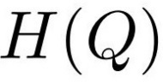

The MapEquation
$$L\left(M\right)=q↷H\left(Q\right)+ \sum_{i=1}^{m}{pi↻H(Pi)}$$
q↷
--- Sum of exit probability of the random walker for each module
--- Probability distribution of the module entering rate
--- Average code length for the movement between modules (inter-module entropy)
p^{i}↻
--- Stay probability of the random walker within a module i
P^{i}
--- Probability distribution of the code of module i
H(P^{i})
--- Average code length of the random walk within the module (intra-module entropy)

Slide 35
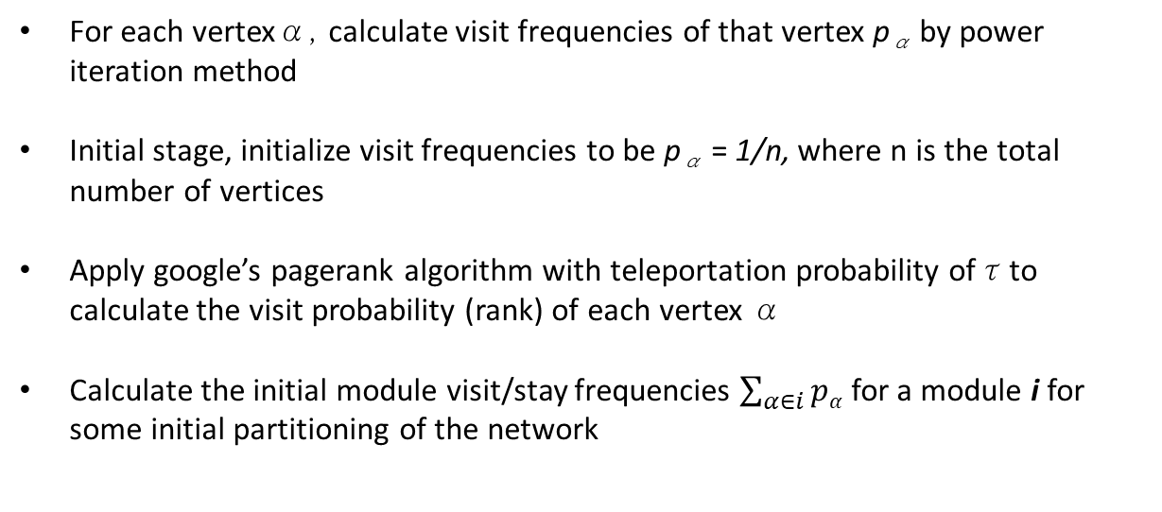
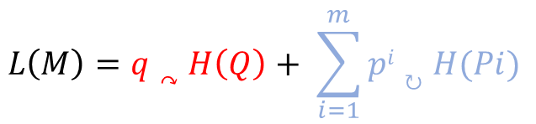
The MapEquation
$$L\left(M\right)=q↷H\left(Q\right)+ \sum_{i=1}^{m}{pi↻H(Pi)}$$
For each vertexα, calculate visit frequencies of that vertex p_{α} by power iteration method
Initial stage, initialize visit frequencies to be p_{α} = 1/n, where n is the total number of vertices
Apply google’s pagerank algorithm with teleportation probability ofτto calculate the visit probability (rank) of each vertex α
Calculate the initial module visit/stay frequencies $\sum_{α∈i}{pα}$ for a module i for some initial partitioning of the network

Slide 36
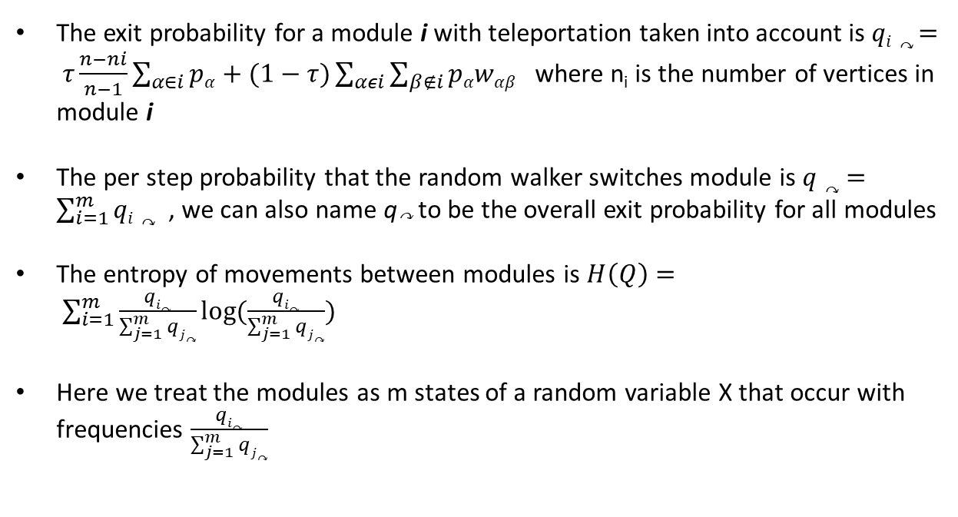
The MapEquation
$$L\left(M\right)=q↷H\left(Q\right)+ \sum_{i=1}^{m}{pi↻H(Pi)}$$
The exit probability for a module i with teleportation taken into account is $qi↷ = τ\frac{n−ni}{n−1}\sum_{α∈i}{pα}+(1−τ)\sum_{αεi}{\sum_{β∉i}{pαwαβ}}$ where n_{i} is the number of vertices in module i
The per step probability that the random walker switches module is $q↷ =\sum_{i=1}^{m}{qi↷}$, we can also name q↷ to be the overall exit probability for all modules
The entropy of movements between modules is $H\left(Q\right)= \sum_{i=1}^{m}{\frac{qi↷}{\sum_{j=1}^{m}{qj↷}}log⁡(\frac{qi↷}{\sum_{j=1}^{m}{qj↷}})}$
Here we treat the modules as m states of a random variable X that occur with frequencies $\frac{qi↷}{\sum_{j=1}^{m}{qj↷}}$

Slide 37
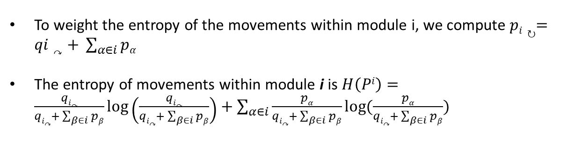
The MapEquation
$$L\left(M\right)=q↷H\left(Q\right)+ \sum_{i=1}^{m}{pi↻H(Pi)}$$
To weight the entropy of the movements within module i, we compute $pi↻=qi↷+ \sum_{α∈i}{pα}$
The entropy of movements within module i is $H\left(Pi\right)=\frac{qi↷}{qi↷+\sum_{β∈i}{pβ}}log\left(\frac{qi↷}{qi↷+\sum_{β∈i}{pβ}}\right)+\sum_{α∈i}{\frac{pα}{qi↷+\sum_{β∈i}{pβ}}}log(\frac{pα}{qi↷+\sum_{β∈i}{pβ}})$

Slide 38
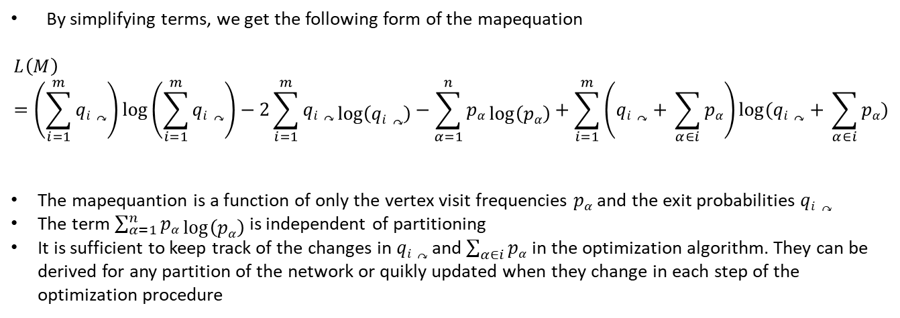
The MapEquation
$$L\left(M\right)=q↷H\left(Q\right)+ \sum_{i=1}^{m}{pi↻H(Pi)}$$
By simplifying terms, we get the following form of the mapequation
$$L\left(M\right)=\left(\sum_{i=1}^{m}{qi↷}\right)\log\left(\sum_{i=1}^{m}{qi↷}\right)−2\sum_{i=1}^{m}{qi↷}\log\left(qi↷\right)−\sum_{α=1}^{n}{pα\log\left(pα\right)+\sum_{i=1}^{m}{\left(qi↷+ \sum_{α∈i}{pα}\right)log⁡(qi↷+ \sum_{α∈i}{pα})} }$$
The mapequantion is a function of only the vertex visit frequencies $pα$ and the exit probabilities $qi↷$
The term $\sum_{α=1}^{n}{pα\log\left(pα\right)}$ is independent of partitioning
It is sufficient to keep track of the changes in $qi↷$ and $\sum_{α∈i}{pα}$ in the optimization algorithm. They can be derived for any partition of the network or quikly updated when they change in each step of the optimization procedure

Slide 39
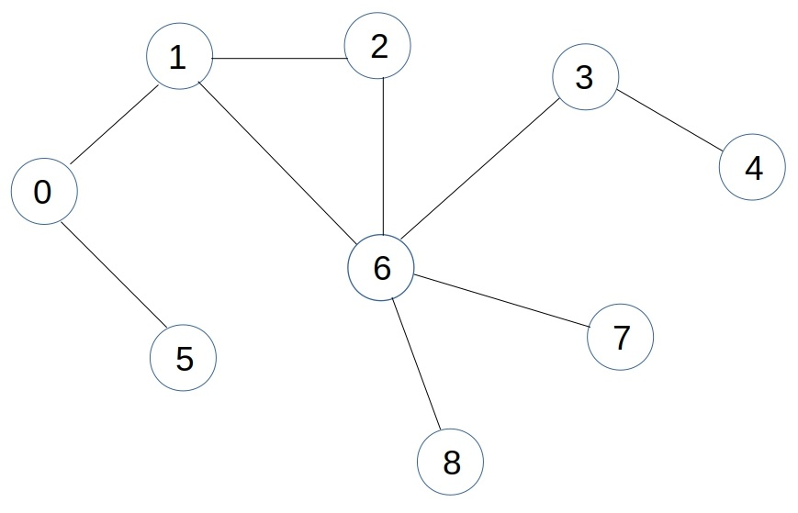
Network Format (CSR)
9 | 20
1 | 5
0 | 2 | 6
1 | 6
4 | 6
3
0 | 6
1 | 2 | 5 | 3 | 7 | 8
6
6

Slide 40
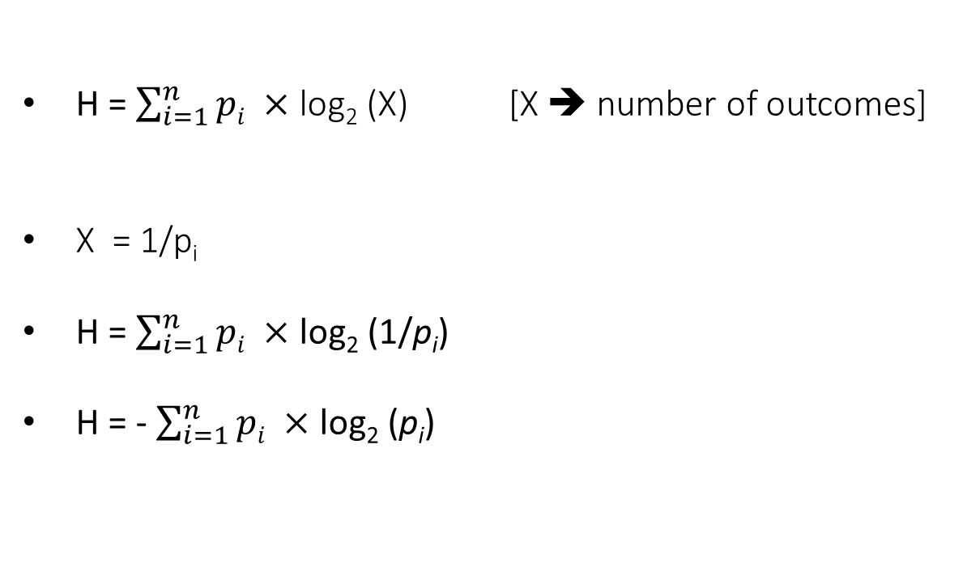
Shanon’s Minimum Entropy Theorem
H = $\sum_{i=1}^{n}{pi} ×$ log₂ (X) [X ➔ number of outcomes]
X = 1/p_{i}
H = $\sum_{i=1}^{n}{pi} ×$ log₂ (1/p_{i})
H = - $\sum_{i=1}^{n}{pi} ×$ log₂ (p_{i})
https://www.khanacademy.org/computing/computer-science/informationtheory/moderninfotheory/v/information-entropy

Slide 41
Example of Shanon’s Entropy
Machine 1 generates 4 events A, B, C, D
P(A) = 0.25
P(B) = 0.25
P(C) = 0.25
P(D) = 0.25
Machine 2 generates 4 events A, B, C, D
P(A) = 0.50
P(B) = 0.125
P(C) = 0.125
P(D) = 0.25
https://www.khanacademy.org/computing/computer-science/informationtheory/moderninfotheory/v/information-entropy

Slide 42
Example of Shanon’s Entropy
Machine 1
P(A) = 0.25
P(B) = 0.25
P(C) = 0.25
P(D) = 0.25
Machine 2
P(A) = 0.50
P(B) = 0.125
P(C) = 0.125
P(D) = 0.25
Is it A?
Is it AB?
N
Y
Is it D?
Y
N
Is it A?
Is it C?
N
Y
Is it C?
Y
Y
N
N
Y
N
https://www.khanacademy.org/computing/computer-science/informationtheory/moderninfotheory/v/information-entropy

Slide 43
Example of Shanon’s Entropy
Machine 1
P(A) = 0.25
P(B) = 0.25
P(C) = 0.25
P(D) = 0.25
#questions = $pA ×2+pB ×2+pC×2+pD×2$
#questions = 0.25$×2+0.25 ×2+0.25×2+0.25×2$
#questions = $2$
https://www.khanacademy.org/computing/computer-science/informationtheory/moderninfotheory/v/information-entropy

Slide 44
Example of Shanon’s Entropy
Machine 2
P(A) = 0.50
P(B) = 0.125
P(C) = 0.125
P(D) = 0.25
#questions = $pA ×1+pB ×3+pC×3+pD×2$
#questions = 0.5$×1+0.125 ×3+0.125×3+0.25×2$
#questions = $1.75$
https://www.khanacademy.org/computing/computer-science/informationtheory/moderninfotheory/v/information-entropy

Slide 45
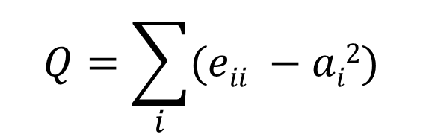
Modularity
$$Q=\sum_{i}{(eii −ai2)}$$
A measure of how well a network is partitioned into communities
Modularity score Q is a positive real fractional number
e_{ii} → the fraction of edges that fall within the communities
a_{i}² → the expected value of the above quantity if the edges fall at random in a network with the same degree sequence

Slide 46
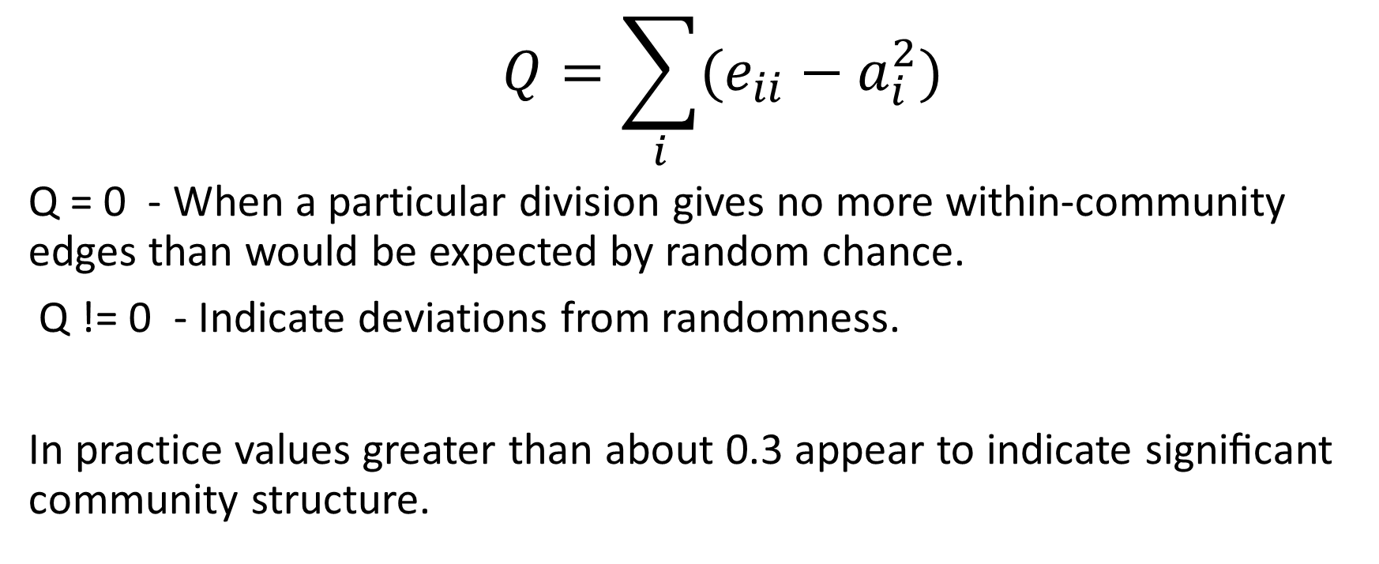
Definitions - Modularity (Q)
$$Q=\sum_{i}{(e_{ii}−a_{i}^{2}})$$
Q = 0 - When a particular division gives no more within-community edges than would be expected by random chance.
Q != 0 - Indicate deviations from randomness.
In practice values greater than about 0.3 appear to indicate signiﬁcant community structure.

Slide 47
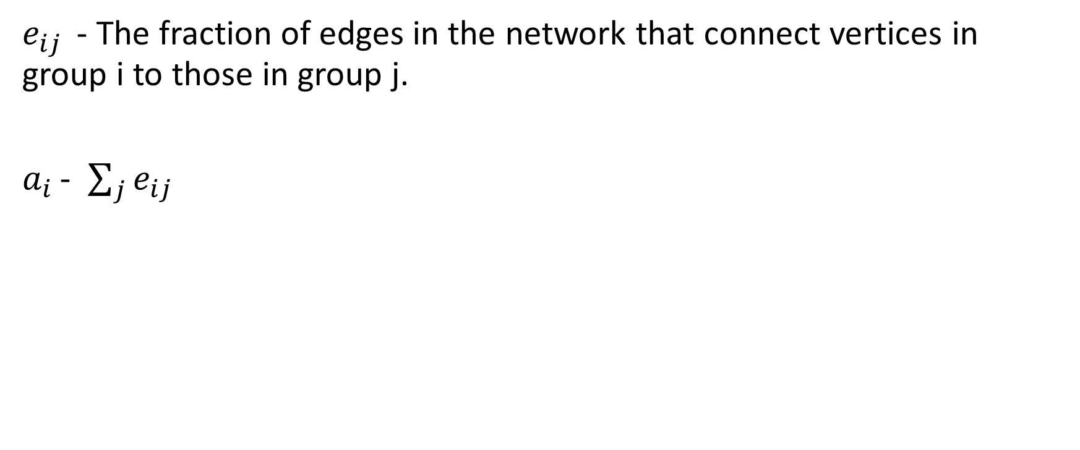
Notations
$e_{ij }$ - The fraction of edges in the network that connect vertices in group i to those in group j.
$a_{i }$- $\sum_{j}{e_{ij}}$
Important: we count every edge twice, as if it was a directed graph.

Slide 48
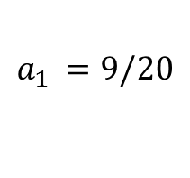
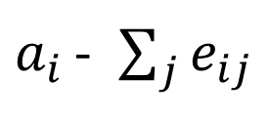
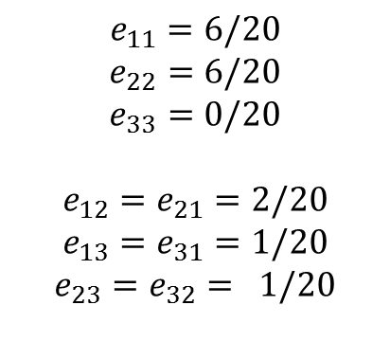
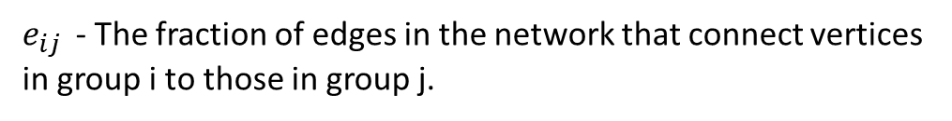
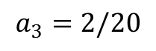
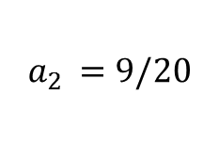
Example
$e_{ij }$ - The fraction of edges in the network that connect vertices in group i to those in group j.
2
$$e_{11}=6/20$$
$$e_{22}=6/20$$
$$e_{33}=0/20$$
$$e_{12}=e_{21}=2/20$$
$$e_{13}=e_{31}=1/20$$
$$e_{23}=e_{32}= 1/20$$
1
$$a_{2 }=9/20$$
$$a_{1 }=9/20$$
3
$a_{i }$- $\sum_{j}{e_{ij}}$
$$a_{3}=2/20$$

Slide 49
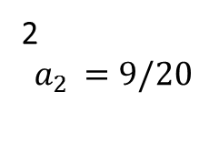
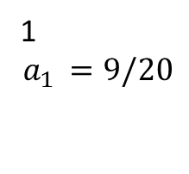
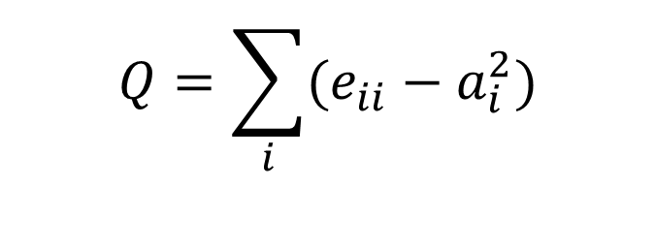
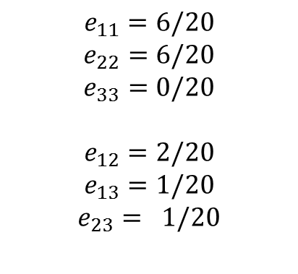
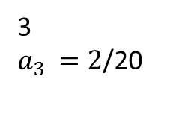
Example - Calculate Q
$$Q=\sum_{i}{(e_{ii}−a_{i}^{2}})$$
$$e_{11}=6/20$$
$$e_{22}=6/20$$
$$e_{33}=0/20$$
$$e_{12}=2/20$$
$$e_{13}=1/20$$
$$e_{23}= 1/20$$
2
$$a_{2 }=9/20$$
1
$$a_{1 }=9/20$$
3
$a_{3 }=2$/20
Q = 6/20 –(9/20)^2 + 6/20 – (9/20)^2 + 0/20 – (2/20)^2

Slide 50
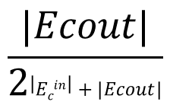
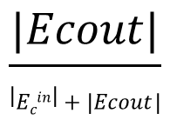
Conductance
$$\frac{|Ecout|}{\left|Ecin\right|+|Ecout|}$$
For Directed Network, Conductance C =
$$\frac{|Ecout|}{2\left|Ecin\right|+|Ecout|}$$
For Undirected Network Conductance C =
When the network contains well-separated disjoint communities, conductance delivers the best quality analysis for detected communities
Conductance means the fraction of total number of edges that point outside the community
A positive real fractional number, higher value means low community structure

